Slide 1
Polling System
Haritha
Shambhi Reddy
Dhanush

Slide 2
About project
Our project is a website to create polls for the make surveys and take surveys easier.
We used angular to create the project.
We can get the results in short time.

Slide 3
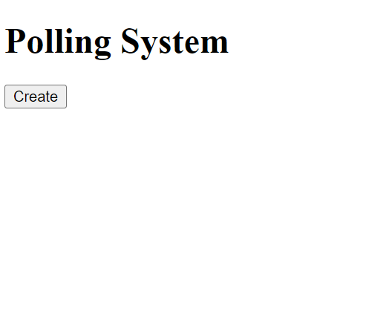
Homepage

Slide 4
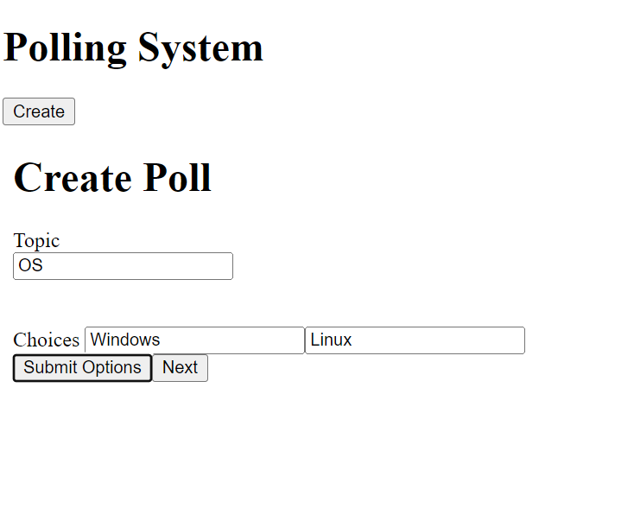
Create Poll

Slide 5
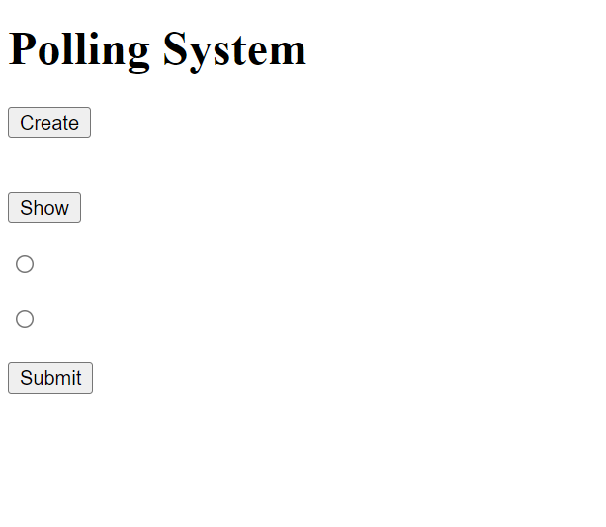
Options

Slide 6
Thank
You

